Slide 1
BANGALORE INSTITUTE OF TECHNOLOGY
K.R Road, V.V Pura, Bengaluru-04
DEPARTMENT OF COMPUTER SCIENCE & ENGINEERING
“INTELLIGENT CHATBOT FOR CSE DEPARTMENT”
Presented by
18P41
1BI18CS016 AMRUTA JOSHI
1BI18CS033 AYESHA A. KUMAR
1BI18CS051 DIKSHA PANDITA
1BI18CS058 HARSHITA SHREE
Under the Guidance of
Prof. Nethravathy V
Assistant Professor
Computer Science and Engineering

Slide 2
Agenda
Introduction
Literature Survey
Requirements Engineering
Project Planning
System Design
1/20

Slide 3
.
Implementation
Testing
Results and performance analysis
Applications
Conclusion

Slide 4
Introduction
On a daily basis, a large number of students contact their teachers or friends for information related to academic matters.
A teacher or student may get a number of queries repeatedly and answering them can be cumbersome .
Chatbots have become a common feature that help the user by answering their questions while giving the user the feel of human interaction.
2/20

Slide 5
Objectives
To minimize the time taken for a student to receive a response for his/her query.
To ensure accurate and precise communication of information to the students.
To ensure that teachers do not have to repetitively answer common questions on a daily basis.

Slide 6
Literature Survey
Sl. No. | Title | Author | Year | Contributions & Drawbacks
1 | Choosing a chatbot development tool | Sandra Juarez, Esther Guerra | 2021 | Compares the various tools available based on technical and non technical factors and helps to make an informed choice.
2 | Review on Chatbot Design Techniques in Speech Conversation Systems | Sameera A. | 2015 | Reviews famous chatbots like Watson by highlighting their unique features and drawbacks.
3 | Implementation of a Chatbot using Natural Language Processing | Niranjan Dandekar , Suyog Ghodey | 2017 | Aim towards creating a conversational Chatbot with the help of NLP as well as pattern matching. Drawbacks: Accuracy of the bot does not match to live support answers. Cost of infrastructure and resources.
4 | Semantic Similarity- A Review of Approaches and Metrics | Ms.D.Akila1 and Dr. C.Jayakumar | 2019 | In this work the author lists the various approaches to semantic similarity Drawbacks :High Computational Cost in some cases Dependent on size of corpus in some cases.
5/20

Slide 7
Sl. No. | Title | Author | Year | Contributions & Drawbacks
5 | Implementation of a Chatbot System using AI and NLP | Tarun Lalwani, Shashank Bhalotia, Ashish Pal, Shreya Bisen, Vasundhara Rathod | 2018 | Presents a fast and efficient college enquiry chatbot making use of lemmatization, POS tagging and sentence sematic similarity. Drawbacks : Database updated regularly based on log file
6 | A chatbot system demonstrating Intelligent Behaviour using NLP | Ameya Vichare, Ankur Gyani, Yashika Shrikhande, Nilesh Rathod | 2015 | Illustration of existing chatbots like Eliza, Alice, Siri. Drawbacks: These chatbot doesn’t save the conversation They doesn’t Truly understand what the query is, it gives responses from the knowledge base
7 | A Smart Chatbot Architecture based NLP and Machine learning | Soufyane Ayanouz, Boudhir Anouar | 2020 | Presents AI concepts needed to build an intelligent conversational agent based on deep learning models(healthcare assistant). Drawbacks : Performance of diagnosis is not up to the mark. Highly generic: Does not provide personalized analysis.
5/20

Slide 8
Sl. No. | Title | Author | Year | Contributions & Drawbacks
8 | UniOntBot: Semantic Natural Language Generation based API approach for Chatbot Communication | Kaneeka Vidanage, Lakindu Gunasekara | 2019 | Proposes a chatbot which contains an knowledge model along with an OWL verbalizer by exposing to the chatbot system through an API. Drawback : - OWL verbalizers are available are on the research level - Proposed system is API based mechanism which is not intelligent enough and can result in static responses at times.
5/20

Slide 9
DRAWBACKS OF EXISITING SYSTEM:
The main drawback of existing system is that they don’t save the history of the conversation.
They doesn’t truly understand what the query is they just gives responses from the knowledge domain stored in database.
They don’t answer the questions that are irrelevant.

Slide 10
Problem Statement
To implement a department specific chatbot that will ideally answer queries pertaining to academics including department, external/internals score and college event related questions.
3/20

Slide 11
Proposed System
Proposed system consists of three main modules:
Personal Query Response System
Queries for internal marks, external marks are personal queries.
Artificial Intelligence Markup Language response system: If the user is trying to make a normal conversation with the bot, the input is mapped to an appropriate pattern in Artificial Intelligence Markup Language (AIML) files.
Query Analysis and Response System: When a user wants some information pertaining to department, the response will be provided through this module.

Slide 12
Requirement Engineering
Software tools used:
Rasa:
Rasa is a tool to build custom AI chatbots using Python and natural language understanding (NLU). Rasa is used for developing AI powered, industrial grade chatbots.
MySQL DB:
MySQL is an open-source relational database management system.

Slide 13
.
NLTK:
This suite of libraries and applications from the University of Pennsylvania has gained significant traction in Python-based sentiment analysis systems since its conception in 2001.
Besides its provision for sentiment analysis, the NLTK algorithms include named entity recognition, tokenizing, part-of-speech (POS) and topic segmentation.

Slide 14
.
Hardware tools used:
PC running Windows / Linux to act as server to host chatbot locally
Processor – Intel core i5

Slide 15
.
User Requirements:
Quick Answer to any kind of queries:
The user should be able to get answers to queries related to many topics.
These include:
Internal or semester end exam dates
Internal and semester end exam results
Holidays
Events

Slide 16
.
General conversation
Reference to past information:
The user’s past chats with the system should be visible to the user so that they don’t have to repeat their questions.
Ability to download relevant information:
The user should be able to download information like screenshot of external or internal results.

Slide 17
Conceptual/Analysis Modelling

Slide 18
.
Use Case Diagram –
Use Case diagram for chatbot

Slide 19
Sequence Diagram -
Sequence Diagram for Chat with User

Slide 20
.
.
Sequence Diagram for Feedback

Slide 21
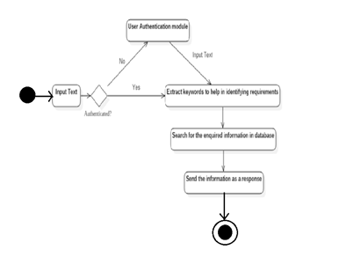
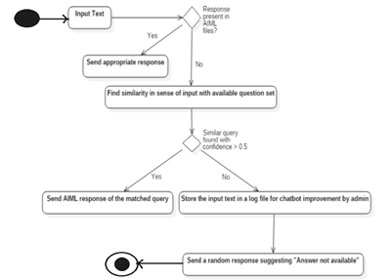
Activity Diagram -
Personal Query Response Activity College Related Query Response Activity

Slide 22
State Chart Diagram –
State Chart Diagram for ChatBot

Slide 23
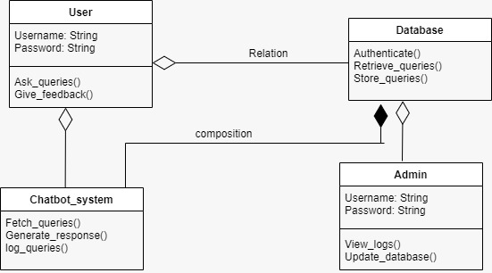
Class Diagram -
Class Diagram for Chatbot

Slide 24
Software requirement documents
1.Introduction:
1.1 Purpose: The purpose of building chatbot is to minimize the time taken for student to receive a response for his/her query and to ensure accurate and precise communication.
1.2 Intended audience: Students as well as faculty of the department are the end users.
1.3 Intended Use: The main issue that the chatbot solves is it saves the time of student and provides accurate information and also ensures that teachers do have to answer for each and every query.
1.4 Scope: Try to build a chatbot that can incorporate a common sense database to provide simple but relevant response to the users.
However we hope to achieve a more dynamic response.

Slide 25
SOFTWARE REQUIREMENTS SPECIFICATION
Functional Requirements
Authentication:
Users should be authenticated based on their USN while querying.
Query:
The system should accept user queries in English language and process it using NLP and AI
Response :
- The user should be given the corresponding answer if the answer is available.
Internals or end semester exam dates

Slide 26
.
Internal and end semester results
Holidays and events
In case of unavailability of a proper response, the system should inform the user with the same along with the most relevant data if available.
4. Admin roles :
The system should allow only admins to make changes to the system.
5. History :
Chats should be able to be archived indefinitely so users can reference past chats.

Slide 27
.
6. Error Handling :
The system should handle error effectively. In case of no internet connection it
show the required message on the UI.
7. Downloadable resource :
The system should provide related documents for an answer when possible that can be
downloaded by the user. These documents can be from the department or from crawling
the VTU site.

Slide 28
.
2) Non-functional requirements:
Speed :
The processing of each request should be done within 10 seconds
User Interface :
The interface should be easy to learn without a tutorial and allow users to accomplish their goal without difficulty. All the available options should be precise and accessible.
Accuracy :
The system should provide correct information to the users.
Scalability :
The system should be easily scalable to serve larger number of users concurrently.

Slide 29
.
3) Domain Requirements
The system should be accessible to the students of the Computer Science department.
The system should be able to easily parse the query into understandable format and provide a suitable response.

Slide 30
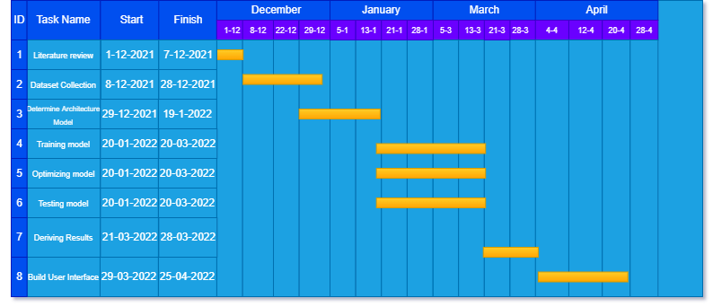
PROJECT PLANNING/SCHEDULING
A Gantt chart, or harmonogram, is a type of bar chart that illustrates a project schedule. This chart lists the tasks to be performed on the vertical axis, and time intervals on the horizontal axis. The width of the horizontal bars in the graph shows the duration of each activity. Gantt charts illustrate the start and finish dates of the terminal elements and summary elements of a project. Terminal elements and summary elements constitute the work breakdown structure of the project.

Slide 31
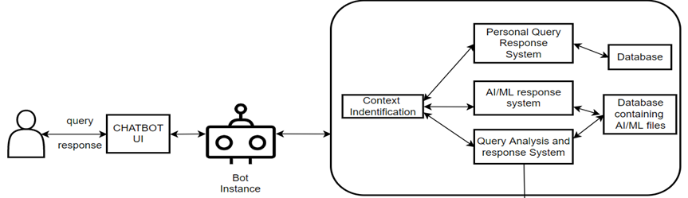
System Design - Architecture
.

Slide 32
Module Decomposition
Personal Query Response System
Artificial Intelligence Markup Language (AIML) response system
Query Analysis and Response System

Slide 33
Module Description
Pre-processing is applied to the input text to standardize the input as per the system’s requirement. Based on the keywords used in the text, appropriate context is recognized.
Personal Query Response System: Queries for internal marks, external marks are personal queries. The input text is processed to extract keywords. Based on the keywords, information required by the user is understood and the information is provided from the database.

Slide 34
.
AIML response system: If the user is trying to make a normal conversation with the bot, the input is mapped to an appropriate pattern in Artificial Intelligence Markup Language (AIML) files. If the response is available, it is sent to the user. If the pattern is not available in AIML files, a response is sent suggesting “Invalid Input”.
Query Analysis and Response System: When a user wants some information pertaining to department, the response will be provided through this module.

Slide 35
.
If the input matches a pattern in the AIML files, the appropriate response will be sent to the user. If the AIML files have no entry for that particular query pattern, keywords are fetched from the input.
An algorithm to check sentence similarity (NLP) is applied to the modified input to check its similarity with the questions of a predefined question-set, whose answers are available.
If a sentence is retrieved with confidence> 0.5, we return the answer of that question as the response.
If no questions map to the user input, the input is saved in a log file for improvement of the system by the admin.

Slide 36
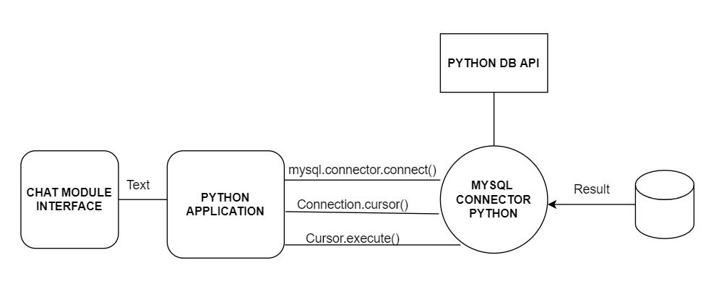
INTERFACE DESIGN

Slide 37

.
)
s
Control buttons
GO BACK
DEPARTMENT CHATBOT
DEPARTMENT CHATBOT
Hello Bot
Hi! How may I help you
Chat bubble
I want to check my semester marks
Chat window
Enter Text Here..
SEND
Rounded button
SAMPLE USER INTERFACE DESIGN

Slide 38
Data Structure Design
Data Structure | Description
YAML | Rasa Open Source uses YAML as a unified and extendable way to manage all training data, including NLU data, stories and rules. YAML is a data serialization language designed to be human-friendly and work well with modern programming languages for common everyday tasks.

Slide 39
.
Data Structure | Description
Entities | Entities are structured pieces of information that can be extracted from a user's message. Entities are annotated in training examples with the entity's name. In addition to the entity name, you can annotate an entity with synonyms, roles or groups.
Synonyms | Synonyms normalize our training data by mapping an extracted entity to a value other than the literal text extracted.

Slide 40
Data Structure | Description
Lookup Tables | Lookup tables are lists of words used to generate case-insensitive regular expression patterns.

Slide 41
ALGORITHM
For Chatbot Response System
Entity Extraction STEP i) Converting to lower case STEP ii) Tokenizing using NLTK’s tokenizer STEP iii) Removing punctuations STEP iv) Removing stop words STEP v) Lemmatization - WordNet

Slide 42
.
2. Intent Extraction let user_query←query
probability ←jaccard(query)
if (probability==0) response← not found
if query in [external marks, internal marks, calender of events etc] response←fetch db()
else if query in [ normal conversations] response← aiml_script_fetch()
if (!response)
jaccard(query,response) if(response) return response else response =AIML(query)
if(prob>0.5)
return response
return response

Slide 43
Algorithm Design
Jaccard Similarity
Jaccard Similarity is a common proximity measurement used to compute the similarity between two objects, such as two text documents. Jaccard similarity can be used to find the similarity between two asymmetric binary vectors or to find the similarity between two sets.
The Jaccard similarity measures the similarity between two sets of data to see which members are shared and distinct. The Jaccard similarity is calculated by dividing the number of observations in both sets by the number of observations in either set. In other words, the Jaccard similarity can be computed as the size of the intersection divided by the size of the union of two sets.

Slide 44
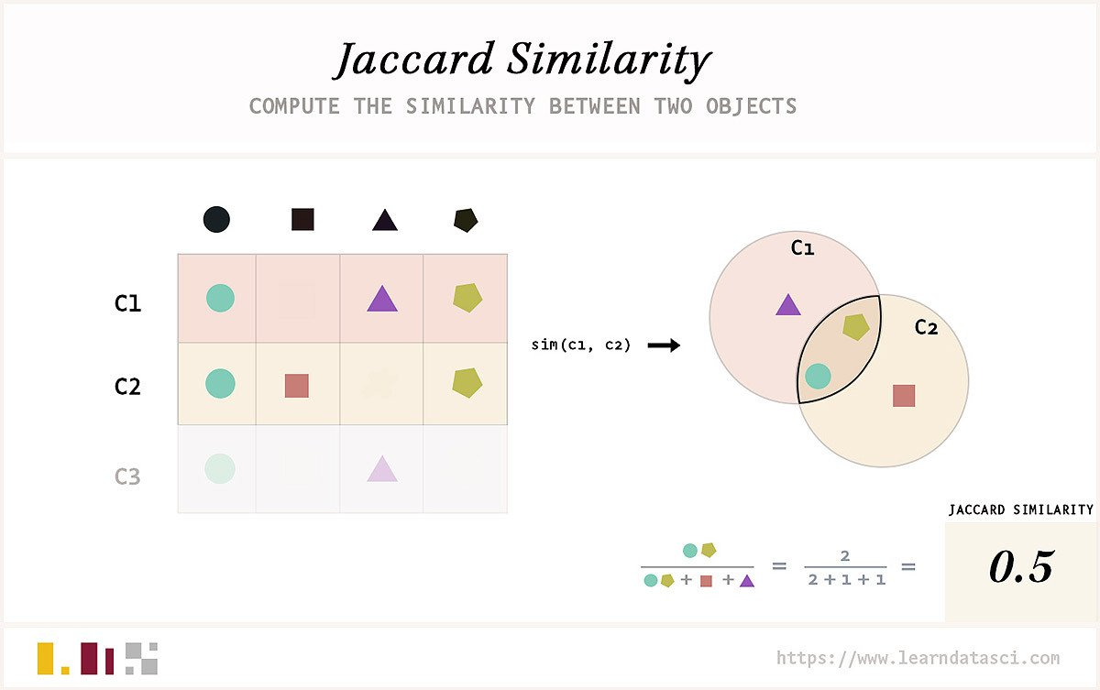

Slide 45
This can be written in set notation using intersection (A∩B) and unions (A∪B) of two sets:
J(A,B) = |A∩B| / |A∪B|
where |A∩B| gives the number of members shared between both sets and |A∪B| gives the total number of members in both sets (shared and un-shared). The Jaccard Similarity will be 0 if the two sets don't share any values and 1 if the two sets are identical. The set may contain either numerical values or strings.
Example : A simple example is given below to compute the Jaccard similarity between the following two sets.
A={0,1,2,5,6}
B={0,2,3,4,5,7,9}

Slide 46
Jaccard Similarity between two sets is calculated as follows
J(A,B)=|A∩B| / |A∪B|=|{0,2,5}| / |{0,1,2,3,4,5,6,7,9}|=3/9=0.33
Python Example:
def jaccard_set(list1, list2):
"""Define Jaccard Similarity function for two sets"""
intersection = len(list(set(list1).intersection(list2)))
union = (len(list1) + len(list2)) - intersection
return float(intersection) / union
# Define two sets
a = [0, 1, 2, 5, 6]
b = [0, 2, 3, 4, 5, 7, 9]
# Find Jaccard Similarity between the two sets
jaccard_set(a, b)

Slide 47
RASA DIET Classifier
The intent classifier needs to be as accurate as possible because the response of the bot largely depends on the output of the intent classifier. it does not require us to write any code, all the preprocessing and implementation is handled in the background. All we have to do is curate training samples carefully and experiment with various NLU pipelines to get the desired results.
Rasa NLU: It is used to perform NLU tasks like intent classification and entity recognition on the user queries. So, basically its job is to interpret messages.
Rasa Core: Rasa core is used to design the conversation. It handles the conversation flow, utterances, and actions based on the previous set of user inputs.
Dual Intent and Entity Transformer(DIET) as its name suggests is a transformer architecture that can handle both intent classification and entity recognition together.
Rasa's DIETClassifier provides state of the art performance for intent classification and entity extraction. This algorithm works on the basis of NLU pipeline

Slide 48
.
There is technically no limit to the types of operations but 3 steps are common to most pipelines: tokenization, featurization, and training or inference.
Tokenization
Tokenization consists in getting the list of words (tokens) from an utterance. For example, the sentence Set up a pipeline for the Rasa DIETClassifier would be tokenized as:
Featurization
Featurization is the process of transforming words into meaningful numbers (or vectors) that can be fed to the training algorithm.
Training / Inference
At training time, the algorithm learns from the features derived from the raw text data. At inference time (when the trained model is used to make predictions), the raw data follows the same path. Utterances are tokenized, features are extracted and used to predict the intent and entities.
"Set", "up", "a", "pipeline", "for", "the", "Rasa", "DIETClassifier"

Slide 49
.
pipeline:
name: WhitespaceTokenizer
-name: CountVectorsFeaturizer
-name: DIETClassifier
pipeline:
- name: SpacyNLP
- name: SpacyTokenizer
- name: CountVectorsFeaturizer
- name: DIETClassifier
pipeline:
- name: WhitespaceTokenizer
- name: CountVectorsFeaturizer
analyzer: word - name: CountVectorsFeaturizer
analyzer: char_wb
min_ngram: 2
max_ngram: 4
- name: DIETClassifier

Slide 50
.
At training time, the DIETClassifier knows from your data which sections of your training utterances are entities.
At inference time, it goes through all the words of a sentence and evaluate if they belong to an entity.
If two or more contiguous words belong to the same entity, then the sequence is tagged as a whole. That is how you can have multi-words entities.
To evaluate if a word should be tagged with an entity, the algorithm looks at the features of:
The word being evaluated
The word preceding the word being evaluated
The word following the word being evaluated.

Slide 51
IMPLEMENTATION
STEP 1: Creating a virtual Environment
We create our project in a virtual environment with the necessary packages and modules included.
STEP 2: Creating training data
This training data is called NLU data, and it houses the phrases and dialogues (intents) we expect from a user. YAML files are used for this purpose. While providing the training data we also tag the entities so that the chatbot knows which quantities are to be extracted.
STEP 3: Defining our Model Configuration
The configuration file defines the NLU and Core components that your model will use. The configuration file defines the components and policies that our model will use to make predictions based on user input. The configurations are defined in the config.yml

Slide 52
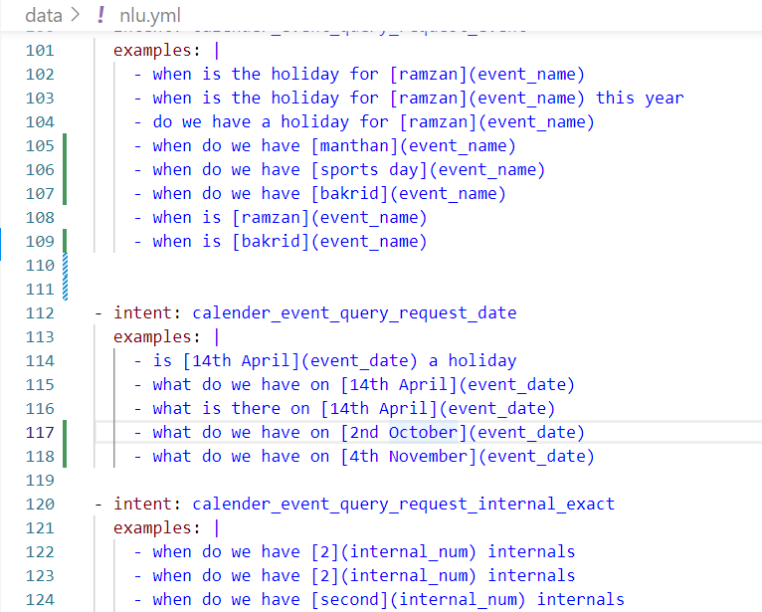
.
Figure a: Examples of intents

Slide 53
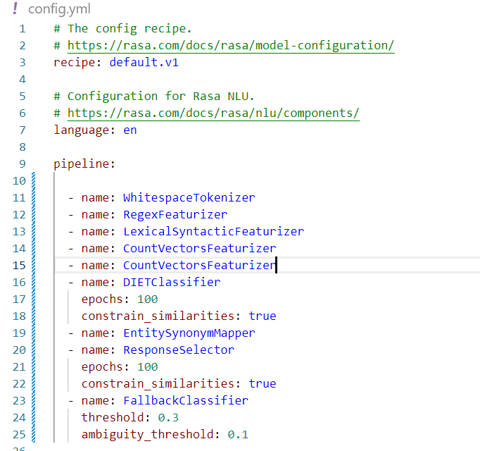
.
Figure b: Configuration file

Slide 54
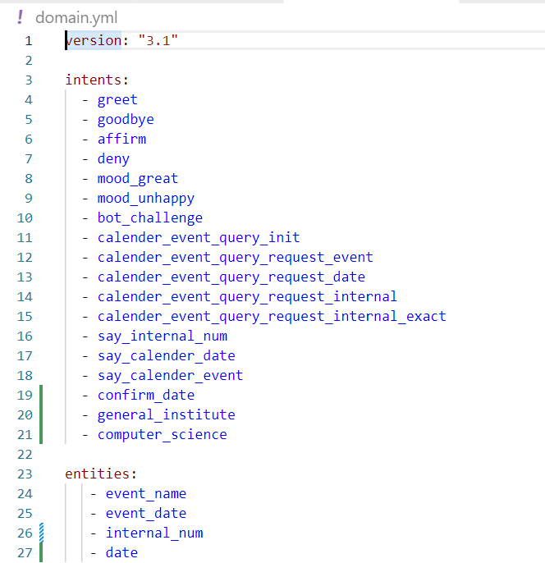
.
STEP 4: Building and Customizing our model
To customize your model, you need to modify the files stories.yml, domain.yml and rules.yml files. The three main terms are entities, responses and stories.
Figure c: Entities and Intents in domain.yml

Slide 55
.
STEP 5: Customizing Chatbot Response
In order to fetch the responses for the Personal Query Response System module of the chatbot, we define our custom functions in the action.py file which are known as actions.
i) Response through Web scraper:
To fetch the external marks information for the user, we have made use of web scraping using selenium.
ii) Response through Database.
For serving the requests related to calendar of events we have parsed the documents and made use o MYSQL database to store the data and query the database

Slide 56
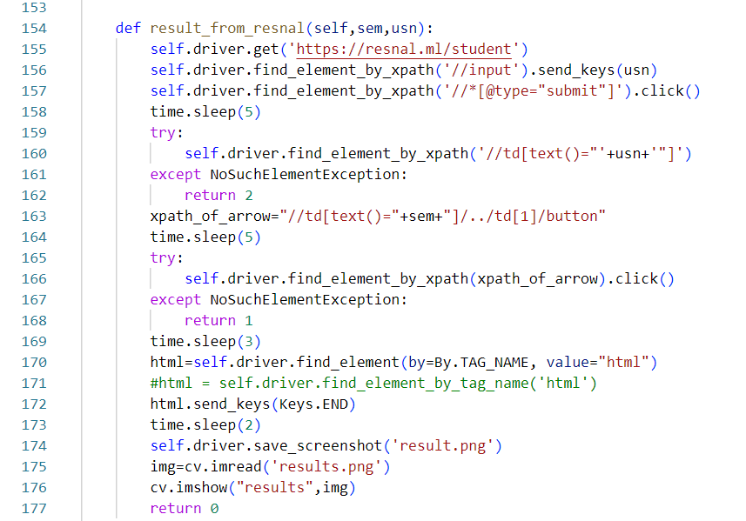
.
Figure d: Code snippet for action to fetch marks

Slide 57
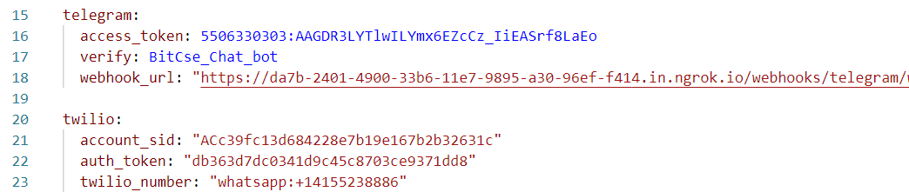
.
STEP 6: Training the model and Testing
The model is then trained by using rasa train. The components of the pipeline that we defined are called in order and the training data is preprocessed and the model learns.
STEP 7: Integrating the Chatbot with frontend
Once our model is trained and tested, we want the college students and faculties to be able to use it. Thus we have integrated our chatbot with a messenger application called Telegram.
Figure e: Code snippet for integrating the frontend

Slide 58
Testing
Unit Testing:
Calendar of Events
Test case 1:
getEvents(date): User query consists of a date, the bot replies with the associated event (if exists).
Test # | Test Data(input) | Expected Result | Actual Result | Pass/ Fail
1 | Query has a valid date with an associated event | Replies with the event name. | Replies with the event name. | Pass
2 | Query has an invalid date (ex- 31 feb) | Should reply – Invalid Date | Replies with “No records found” | Fail
3 | Query has a date which is outside of current academic year | Generate an error message saying “Please enquire with the current academic year” | Replies with “No records found” | Fail

Slide 59
Unit Testing:
Calendar of Events
Test case 2:
getDate(event): User query consists of an event, the bot replies with associated date (if event exists).
Test # | Test Data(input) | Expected Result | Actual Result | Pass/ Fail
1 | Query consists of an existing event. | Replies with the associated date. | Replies with the associated date. | Pass
2 | Query consists of an invalid event (ex- 4th internal) | Generate an error message saying Invalid Input | Replies with No records found | Fail
3 | Query consists of an event which does not exist (ex- Holi) | Generate an error message saying This event does not exist. | Replies with No records found | Fail

Slide 60
Unit Testing:
End Semester Marks
Test case 1:
getExternalMarks(semester, USN): User asks for his/her external marks with inputs semester and USN.
Test # | Test Data(input) | Expected Result | Actual Result | Pass/ Fail
1 | Query consists of valid semester and valid USN. | Generates the external result. | Generates the external result. | Pass
2 | Query consists of invalid semester. | Generate an error message saying Invalid sem. Enter the sem again. | Generates “Invalid sem. Enter the sem again.” | Pass
3 | User gives valid semester but invalid USN. | Error message – “Invalid USN. Enter the USN again.” | Generates “Invalid USN. Enter the USN again.” | Pass

Slide 61
Integrated manual testing:
Calendar of Events and UI
Test case 1:
getEvents(date) and UI: User query consists of a date, the Telegram bot replies with the associated event (if exists).
Test # | Test Data(input) | Expected Result | Actual Result | Pass/ Fail
1 | Query has a valid date with an associated event | Generate a message with the associated event and if it is a holiday or not. | Generates the event name with the statement of whether it is a holiday or not. | Pass
2 | Query has an invalid date (ex- 31 feb) | Should reply – Invalid Date | Generates the message “No records found” | Fail
3 | Query has a date which is outside of current academic year | Generate an error message saying “Please enquire with the current academic year” | Generates the message “No records found” | Fail

Slide 62
Integrated manual testing:
Calendar of Events and UI
Test case 2:
getDate(event) and UI: User query consists of an event, the Telegram bot replies with associated date (if event exists).
Test # | Test Data(input) | Expected Result | Actual Result | Pass/ Fail
1 | Query consists of an existing event. | Responds with the associated dates | Displays the dates | Pass
2 | Query consists of an invalid event (ex- 4th internal) | Generate an error message saying Invalid Input | Generates random message | Fail
3 | Query consists of an event which does not exist (ex- Holi) | Generate an error message saying This event does not exist. | Generates the message “No records found” | Fail

Slide 63
Integrated manual testing:
End Semester results and UI
Test case 1:
getExternalMarks(semester,USN) and UI: User asks for his/her external marks for particular semester with semester and USN as inputs.
Test # | Test Data(input) | Expected Result | Actual Result | Pass/ Fail
1 | Query consists of a valid USN and valid semester | Show the result screenshot | Displays the result screenshot | Pass
2 | User provides invalid USN | Error message – “Invalid USN. Enter the USN again.” | Displays the expected result | Pass
3 | User leaves USN blank | Error message – “Invalid USN. Enter the USN again.” | Generates random message | Fail

Slide 64
.
Results and Performance Analysis
Confusion matrix:
Confusion matrix is a table that is often used to describe the performance of a classification model (or “classifier”) on a set of test data for which the true values are known.
It allows easy identification of confusion between classes e.g. one class is commonly mislabeled as the other.

Slide 65
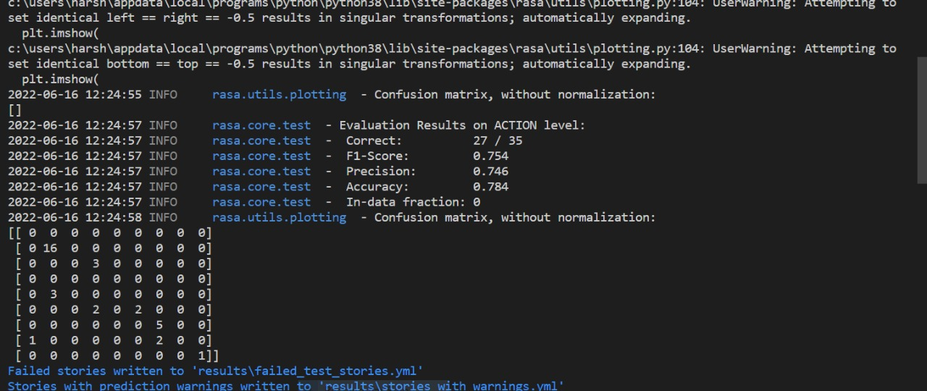
Rasa core evaluation

Slide 66
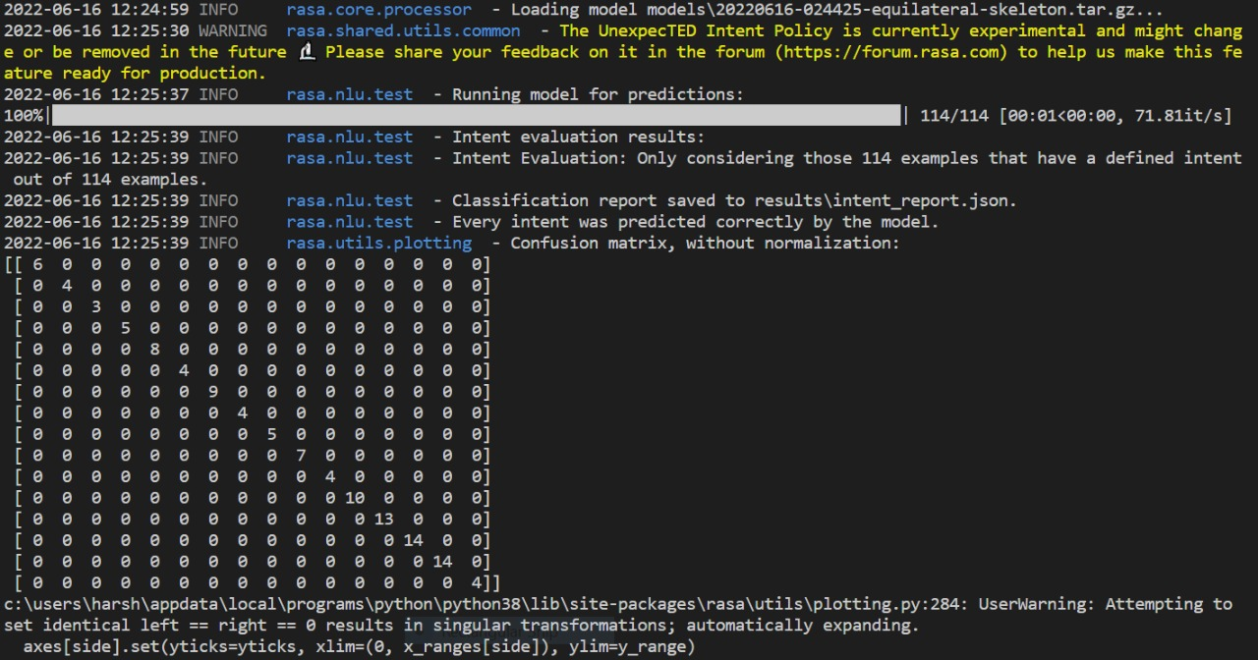
Confusion matrix for intents

Slide 67
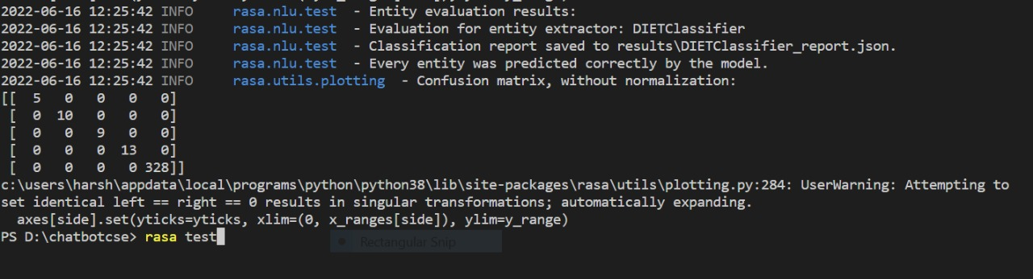
Confusion matrix for entities

Slide 68
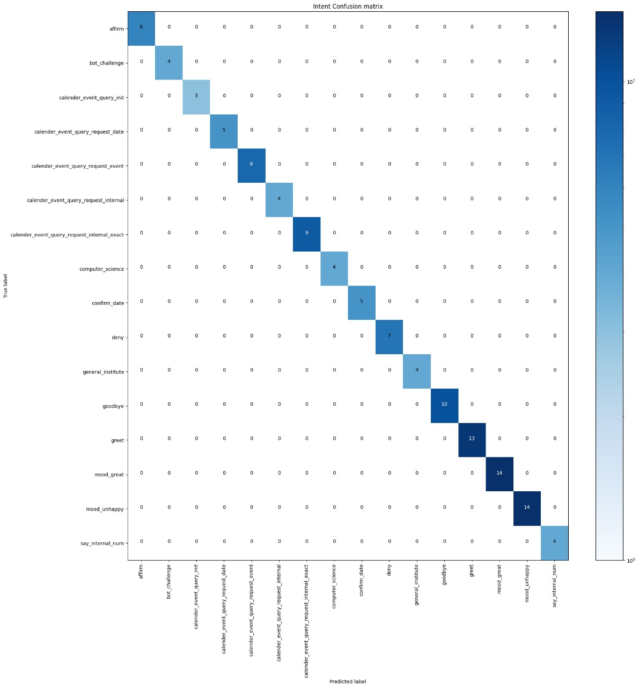
.
Above figure shows confusion matrix for intent classification in the above figure boxes that are darkened indicates particular statement or is classified to particular intent, if it is classified to different intent class then we would get uneven graph. The above confusion matrix shows 100% accuracy in classifying all the intents.

Slide 69
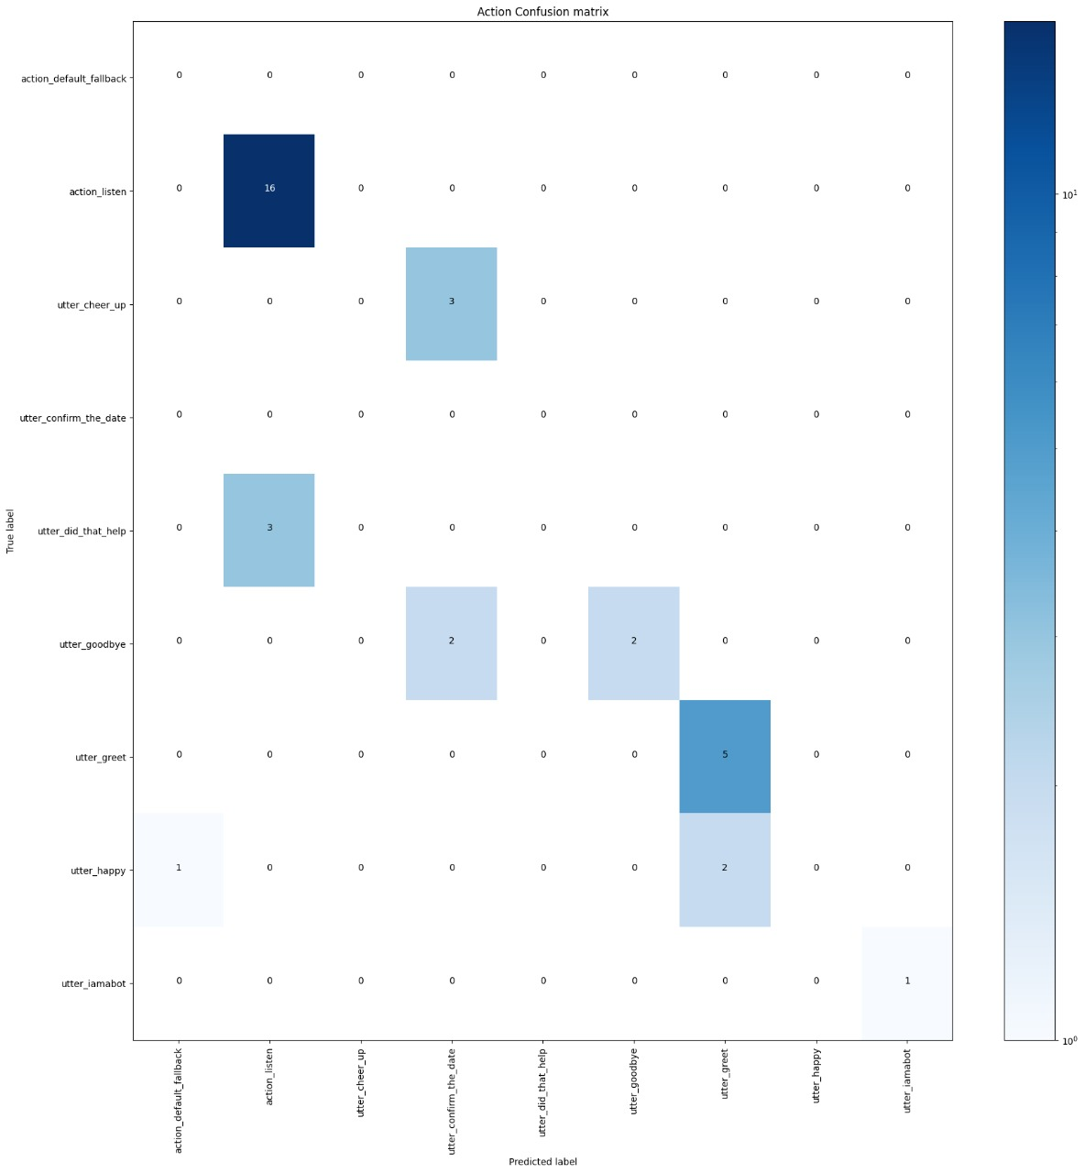
Action – confusion matrix

Slide 70
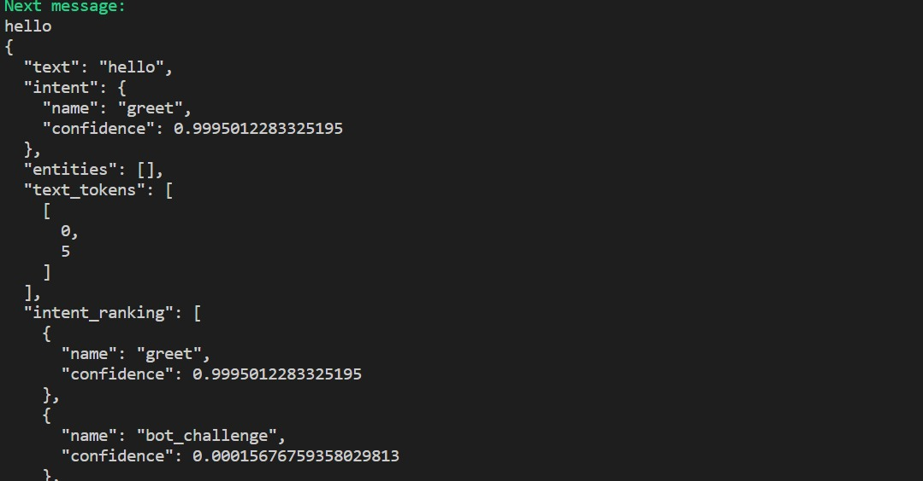
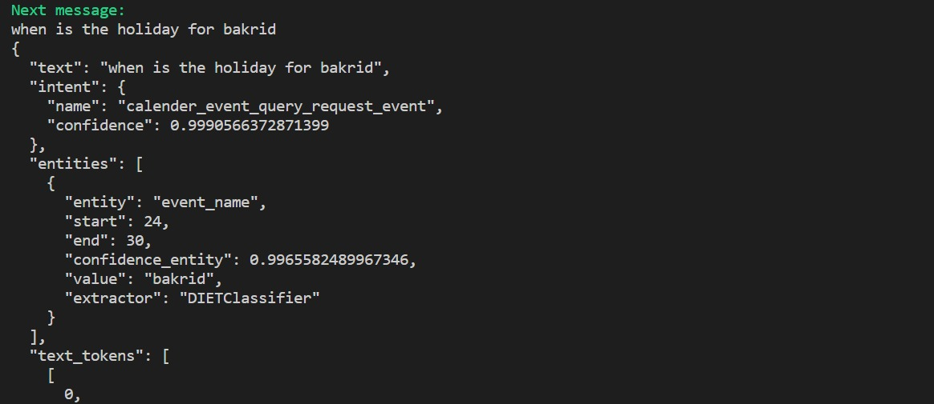
Intents Classification confidence
In the above figure shows the confidence level for classifying the “when is the holiday for bakrid” statement to the claender_event_query_request_event intent.

Slide 71
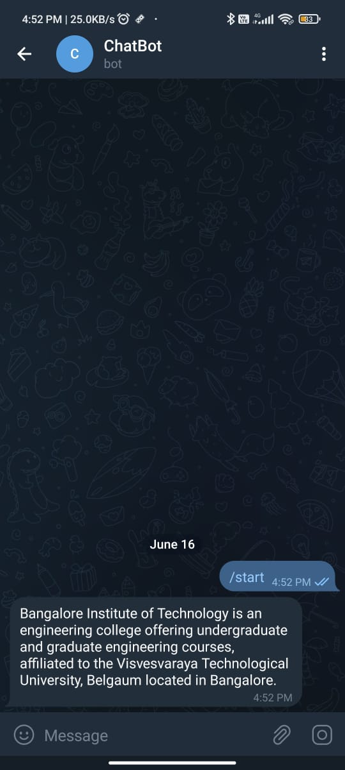
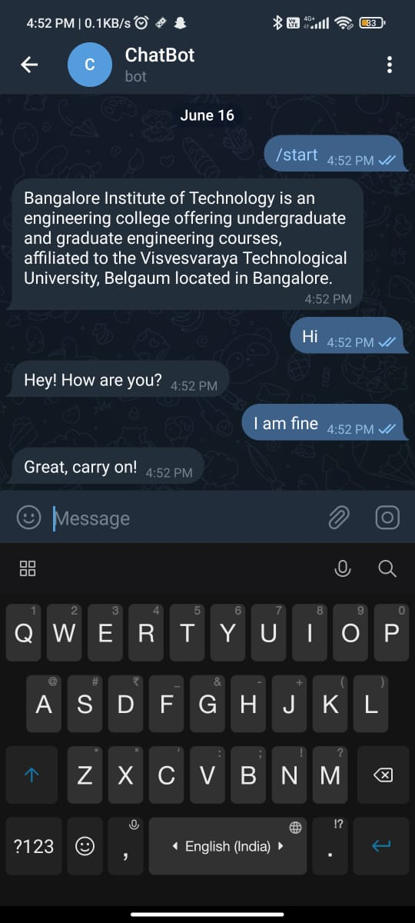
Snapshots
Start screen snapshot
Snapshot for greet intents

Slide 72
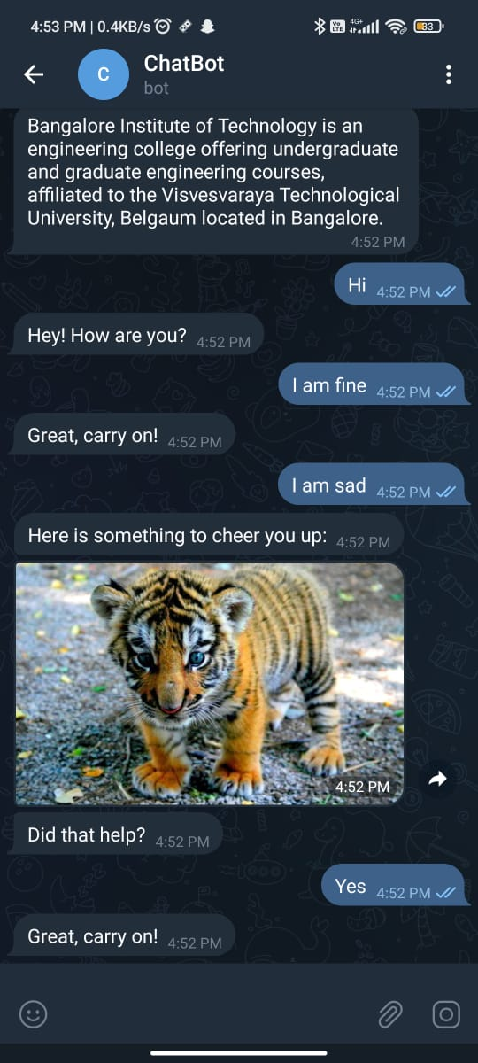
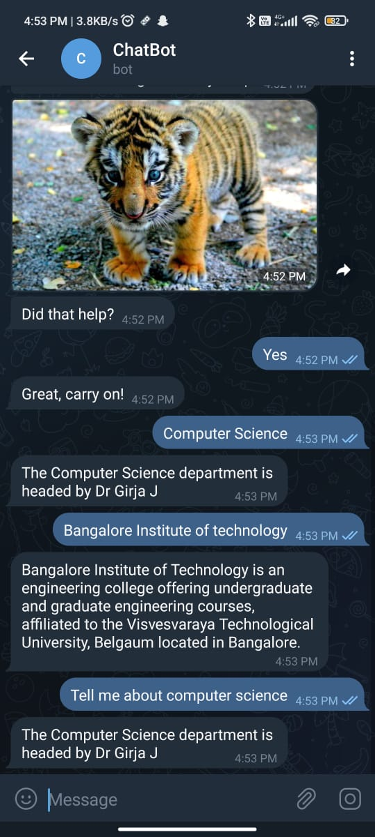
.
Snapshot for normal conversation
Snapshot for department details

Slide 73
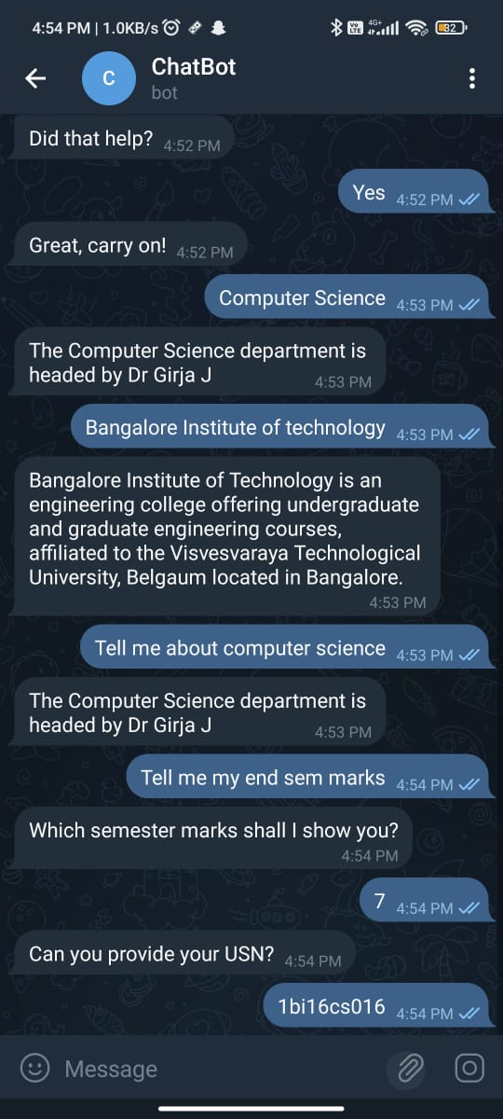
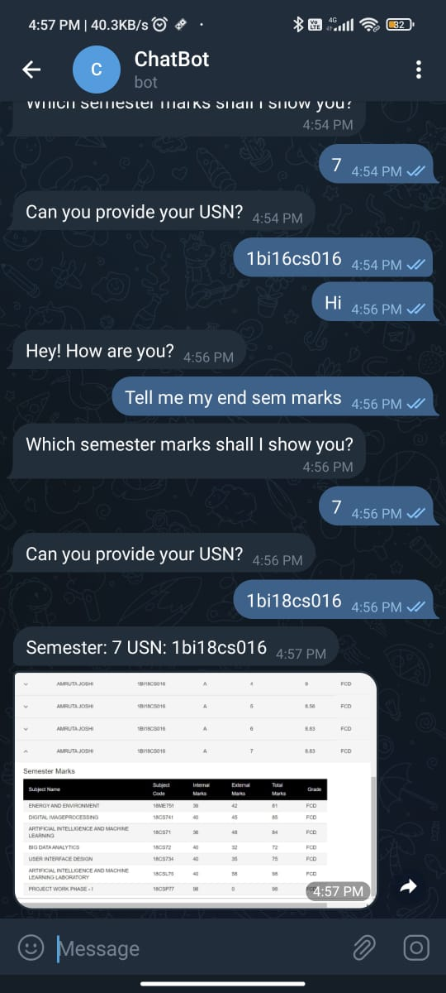
.
Snapshot for fetching external marks
Snapshot for fetching external marks

Slide 74
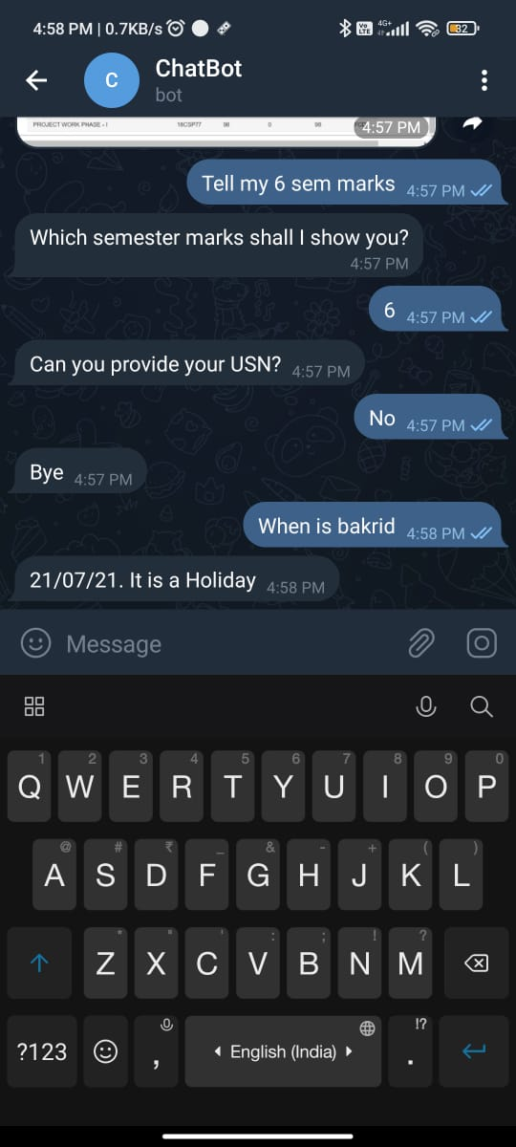
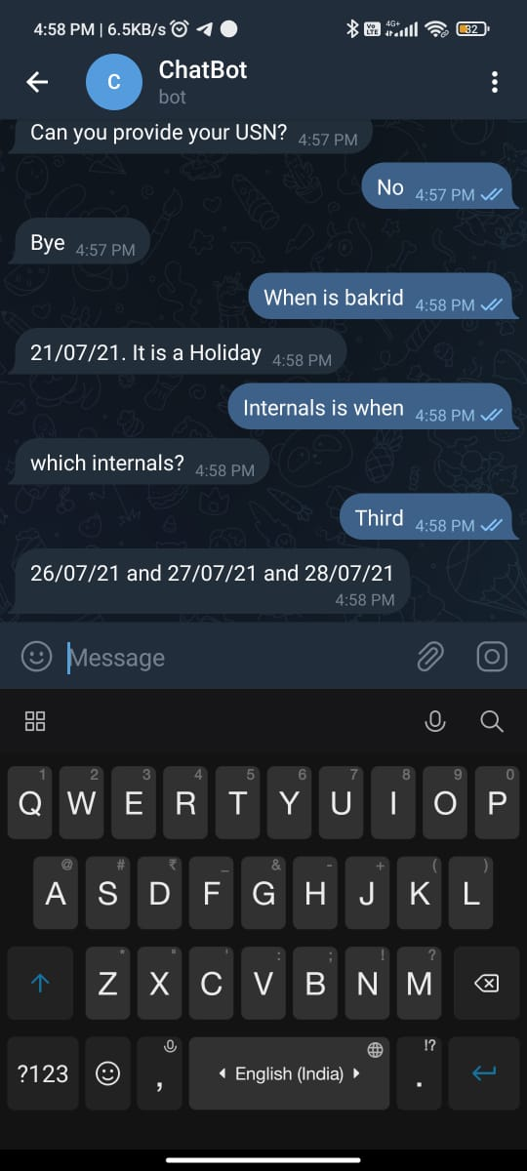
.
Snapshot for fetching holiday details
Snapshot for fetching internal dates

Slide 75
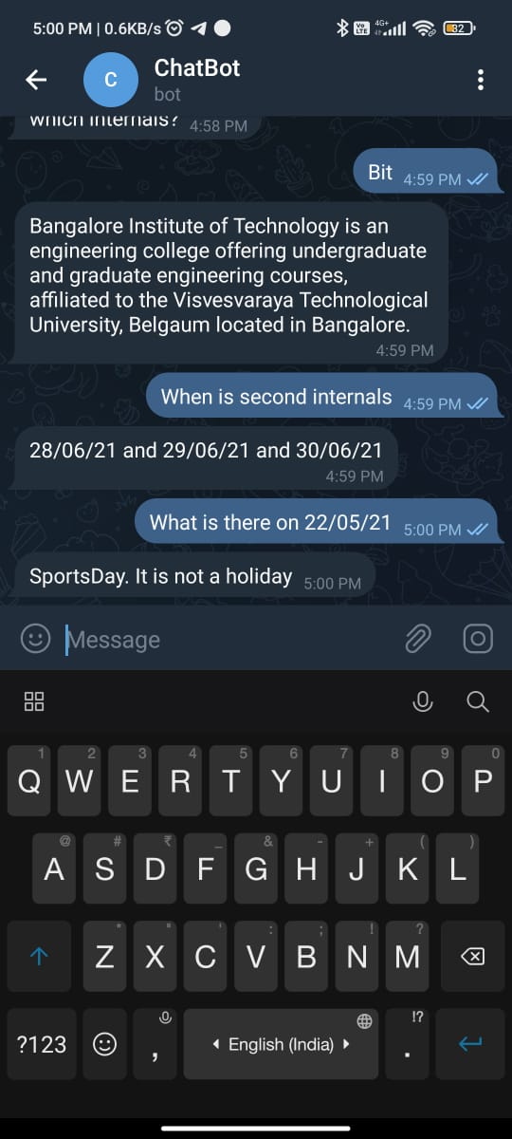
.
Snapshot for fetching holiday details

Slide 76
APPLICATIONS
The chatbot can be used by staff and students of the department to obtain information in a quick and easy manner.
It can be used by students to obtain their internal or external marks.
Students and teachers can use the system to ask questions related to the calender of events.
Students and teacher can ask general questions relating to the department like the vision or mission.

Slide 77
CONCLUSION AND FUTURE SCOPE
The department chatbot will avert the need to visit multiple platforms and people for information and provide a single interface for all queries in the proposed domain and receive faster responses.
The chatbot is intended to simulate a human conversation.
As future enhancements we can also include voice based queries where user will give voice input to the bot and receive a text output. After successful execution, the chatbot can be extended to other departments as well.

Slide 78
REFERENCES
[1] Mohammed Benhmed . “A Smart Chatbot Architecture based NLP and Machine learning for health care assistance”, IEEE Conference, Vol. 1, Issue 4, April 2020
[2] Dr. Poonam Sawant . “Design of Chatbot for New Research Scholars”, Turkish Online Journal of Qualitative Inquiry, Vol. 12, Issue 8, July 2021
[3] Shashank Bhalotia, Ashish Pal. “Implementation of a Chatbot System using AI and NLP” , International Journal of Innovative Research in Computer Science & Technology, Vol. 6, Issue 3, May 2018
21

Slide 79
.
[4] Tarun Lalwani, “Implementation of a Chatbot System using AI and NLP “, International Journal of Innovative Research in Computer Science & Technology (IJIRCST) ISSN: 2347-5552, Volume-6 May 2018
[5] Ms. D. Akila and Dr. C. Jayakumar, “Semantic Similarity- A Review of Approaches and Metrics”, International Journal of Applied Engineering Research, 2019
[6] Kaneeka Vidanage, Lakindu Gunasekara “UniOntBot: Semantic Natural Language Generation based API approach for Chatbot Communication”, National Information Technology Conference (NITC), 2019
[7] Soufyane Ayanouz and Boudhir Anouar, “A Smart Chatbot Architecture based NLP and Machine Learning for Health Care Assistance”, The Fifth International Conference on Smart City Applications, 2020

